Slide 1
IOT 4117: IoT Architecture and Technologies
Md. Habibur Rahman
Lecturer
Department of ICT, BDU

Slide 2

Chapter 20
Network Layer:
Internet Protocol
Copyright © The McGraw-Hill Companies, Inc. Permission required for reproduction or display.

Slide 3
Fragmentation
Why Fragmentation is Required?
A datagram can travel through different networks whose Protocols are defined by the data link and Physical Layer.
We know that at the data link layer we deal with Frames.
For different network Protocols at data link layer we have different formats and sizes of frames.
Now we also know that the Packet from network layer called datagram (Header + data) act completely as data for the data link Frame.

Slide 4
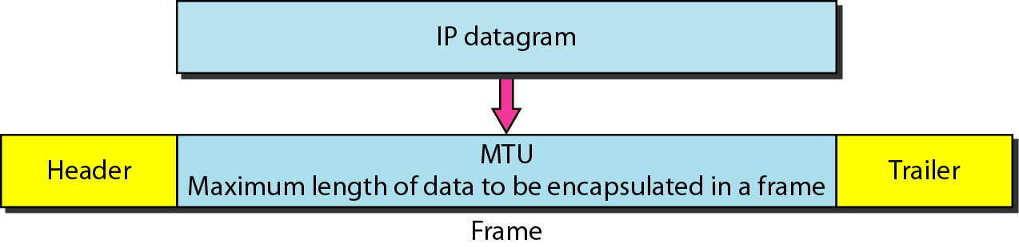
Figure 20.9 Maximum transfer unit (MTU)

Slide 5
Continued
Different Data link layer Protocols e.g. X.25, Frame Relay, Ethernet etc have different frame formats in which there is a field that limits the size of the Data in the frame called Maximum Transfer Unit.
Thus in many cases (datagram traveling from LAN to WAN) it is required to fragment the datagram according to the MTU of the underlying network.

Slide 6
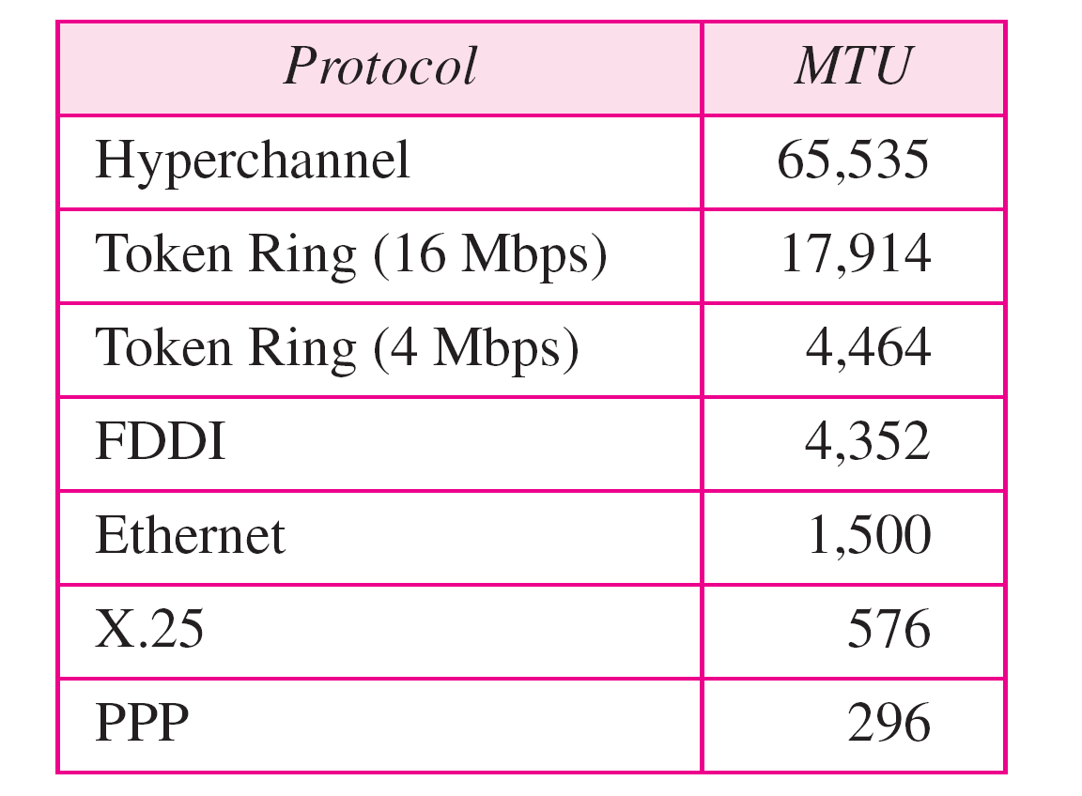
Table 20.5 MTUs for some networks

Slide 7
Fields Related To Fragmentation
Identification
16-bit field
Each datagram is assigned a unique number
When the datagram is fragmented the same identification number is copied to all the fragments.
Flags
3 bit field
1st bit is reserved

Slide 8
Continued…..
2nd bit is Do not Fragment
if the value of this field is 1 the machine must not fragment the datagram. If it cannot pass the datagram though any available physical network, it discards the datagram and sends and ICMP error message to the source host.
If the value is 0, this means that whenever required the datagram can be fragmented according to the requirement of the physical network it is travelling.
3rd bit is More Fragment
If its value is 1, it means this is not the last fragment more fragments have to come.
If its value is 0, it means this is the last fragment or the only fragment.

Slide 9

Figure 20.10 Flags used in fragmentation

Slide 10
Continued…..
Fragmentation Offset
13 bit Field
Shows the relative position of the fragment in the whole datagram.
Offset is measured in units of 8 bytes.

Slide 11
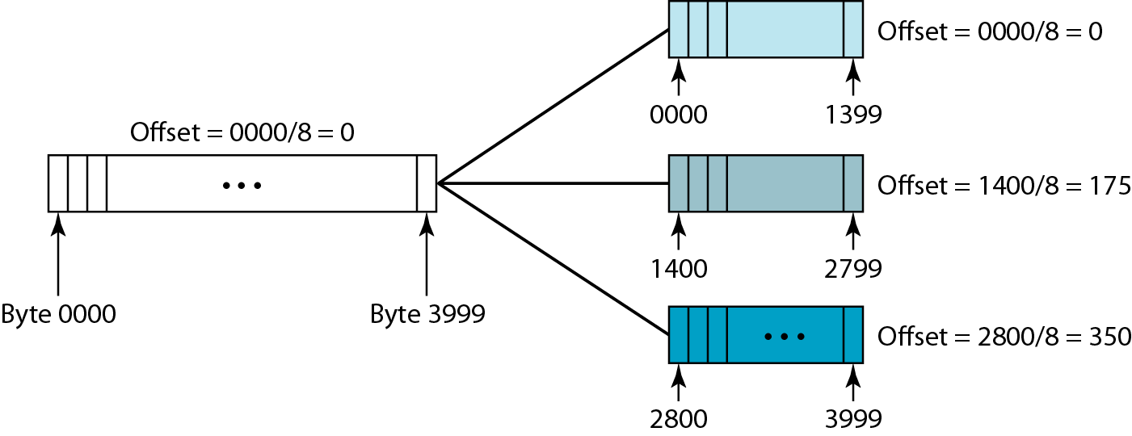
Figure 20.11 Fragmentation example

Slide 12
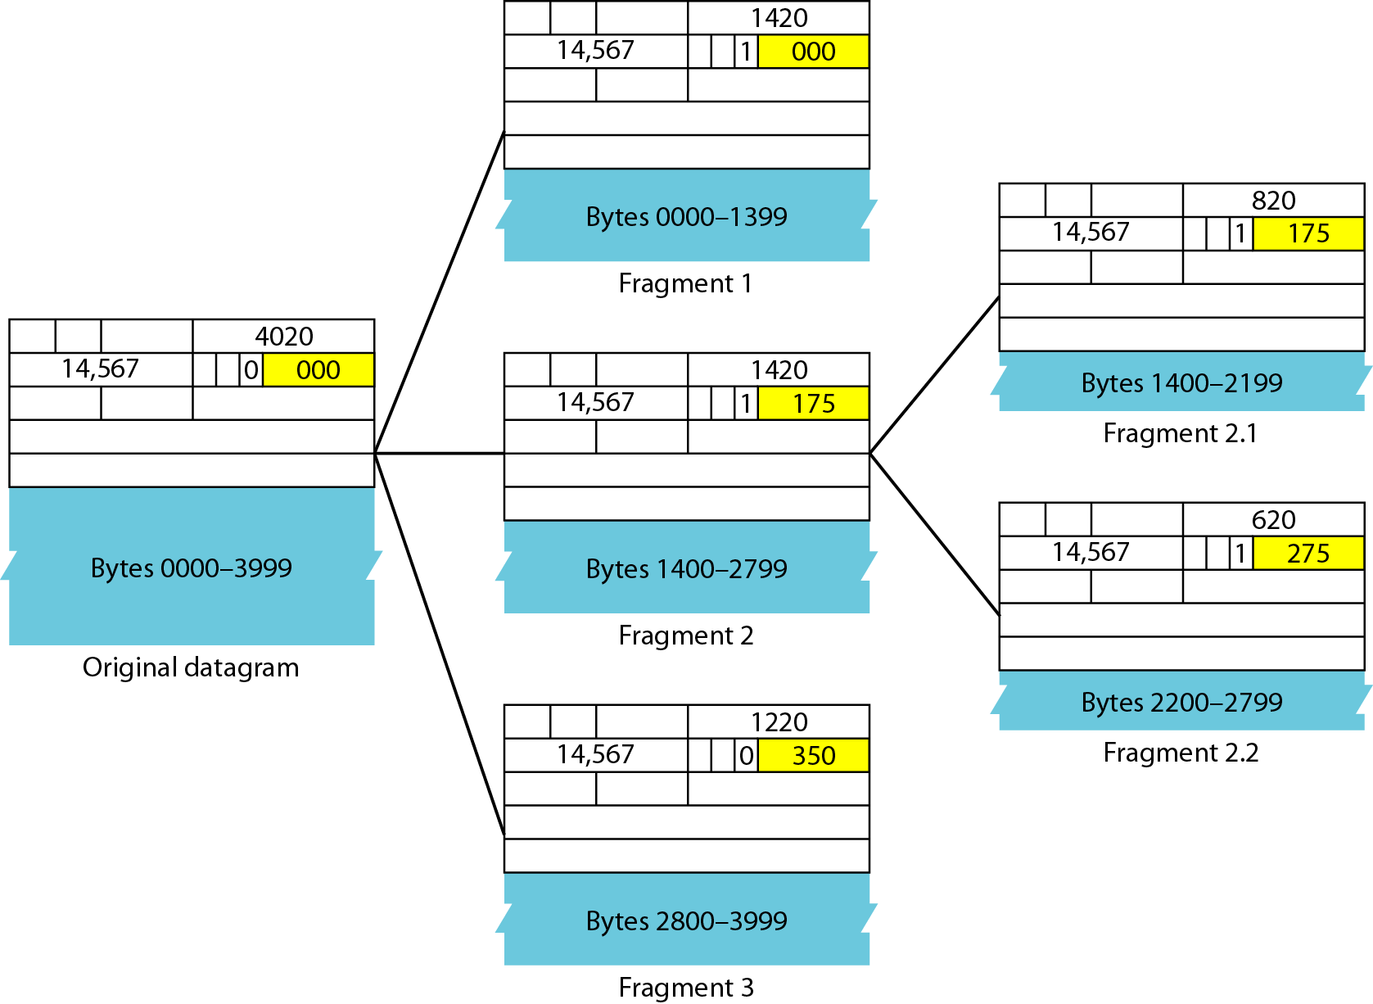
Figure 20.12 Detailed fragmentation example

Slide 13
Example 20.5
A packet has arrived with an M bit value of 0. Is this the first fragment, the last fragment, or a middle fragment? Do we know if the packet was fragmented?
Solution
If the M bit is 0, it means that there are no more fragments; the fragment is the last one. However, we cannot say if the original packet was fragmented or not. A non-fragmented packet is considered the last fragment.

Slide 14
Example 20.6
A packet has arrived with an M bit value of 1. Is this the first fragment, the last fragment, or a middle fragment? Do we know if the packet was fragmented?
Solution
If the M bit is 1, it means that there is at least one more fragment. This fragment can be the first one or a middle one, but not the last one. We don’t know if it is the first one or a middle one; we need more information (the value of the fragmentation offset).

Slide 15
Example 20.7
A packet has arrived with an M bit value of 1 and a fragmentation offset value of 0. Is this the first fragment, the last fragment, or a middle fragment?
Solution
Because the M bit is 1, it is either the first fragment or a middle one. Because the offset value is 0, it is the first fragment.

Slide 16
Example 20.8
Offset is measured in units of 8 bytes. so if offset value is 100, we get it by x/8=100 where x is starting position number, or the number of the first byte. s0, x=8*100=800
A packet has arrived in which the offset value is 100. What is the number of the first byte? Do we know the number of the last byte?
Solution
To find the number of the first byte, we multiply the offset value by 8. This means that the first byte number is 800. We cannot determine the number of the last byte unless we know the length.

